Slide 1
Applies Data Structure and Application
Dr Sachin K Saxena Sr Data Analyst, Portugal, MNC
Ex-Sr Software Engineer - Data Scientist

Slide 3
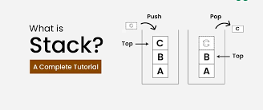
Content
Stacks: Array Representation and Implementation of Stack,
Stacks Operations
Industry example of Stack
Evaluation of Postfix Expression

Slide 4
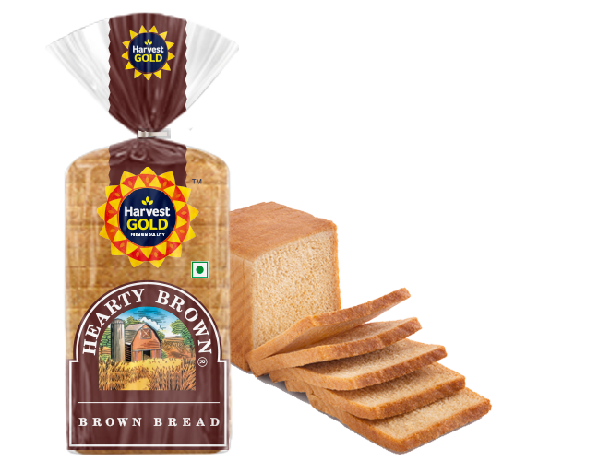
Why to study so many data structures?
Answer: Choice of data structure and efficient problem solving
The importance of algorithms and data structures:
Data structures and algorithms enable us to solve everyday problems
using efficient code
The course could be taught in any programming language

Slide 5
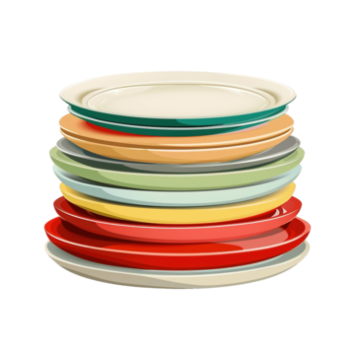

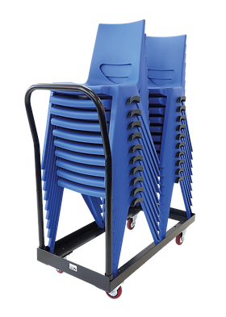
Stacks

Slide 6
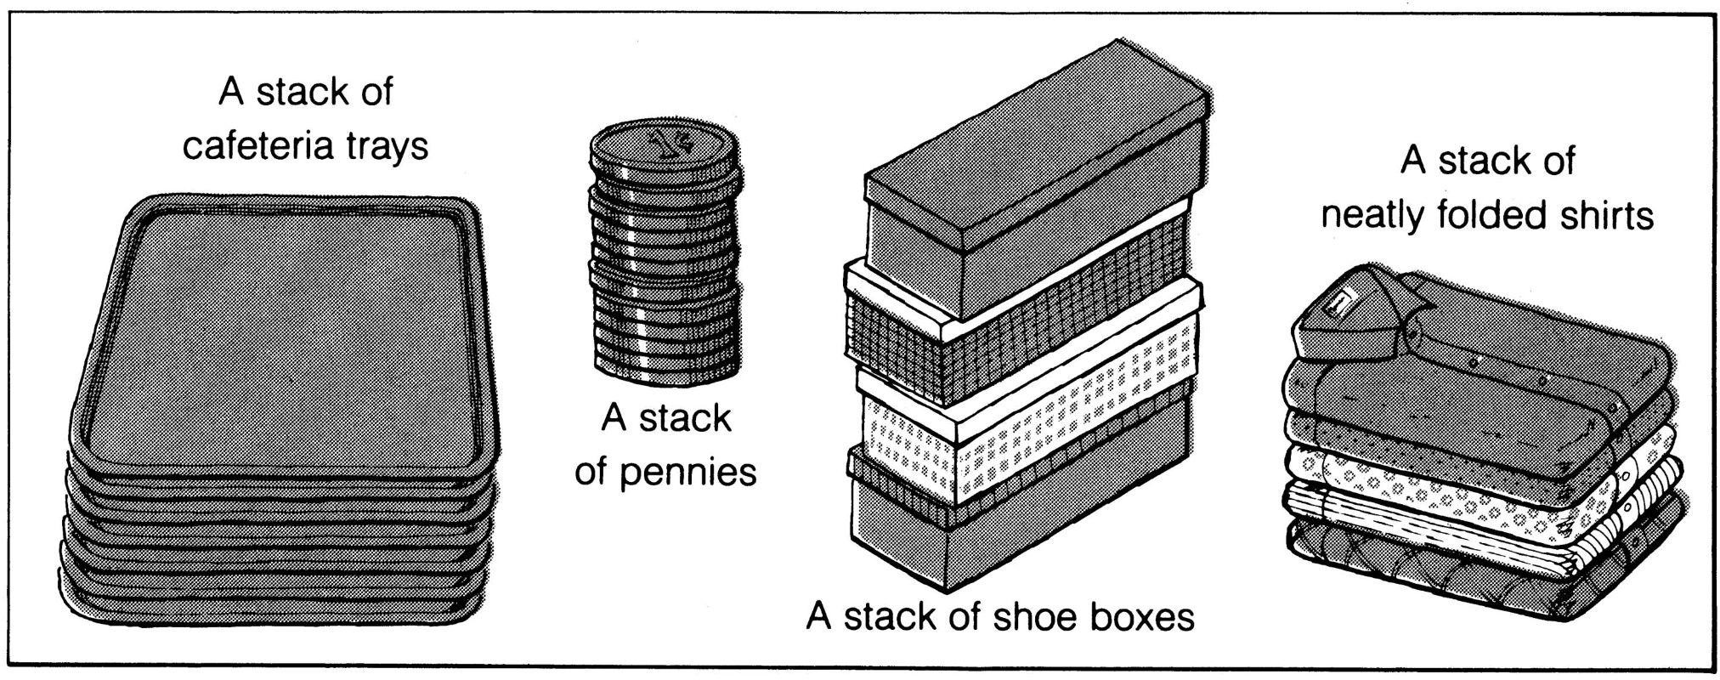
Stacks

Slide 7


Algorithms and data structures
Algorithm: set of instructions that solve a problem
1. Design
Data structures: hold and manipulate data when we execute an algorithm
Advanced data structures: linked lists, stacks, queues...
2. Code

Slide 8
Stacks
A Stack is a linear data structure that only allows inserting, deleting and querying elements at one of its ends, which we call the top.
LIFO type structure (Last In, First Out), in which the last element that enters is the first element that leaves.
In C++ we declare a stack using stack<T> where T is a defined type.

Slide 9
Stacks
Insert
is
called
push.
Removing
the
top
element
is
called
pop.

Slide 10
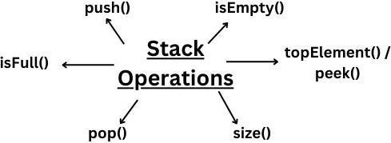
Stacks Operations

Slide 11
Stacks Operations
push(5)
5
top

Slide 12
Stacks Operations
push(8)
8
5
top

Slide 13
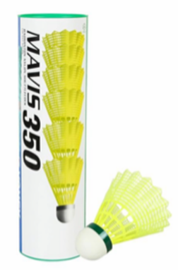
Stacks Operations
pop()
4
8
5
top

Slide 14
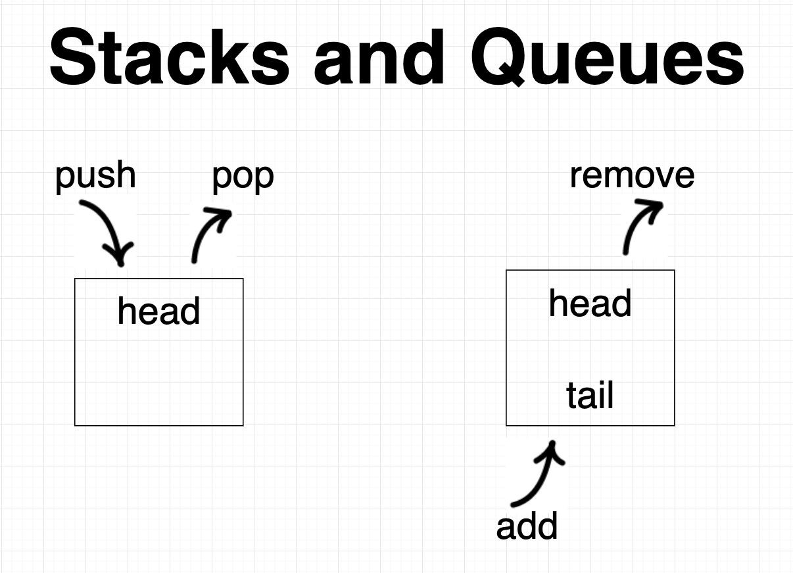
Stacks vs Queue

Slide 15
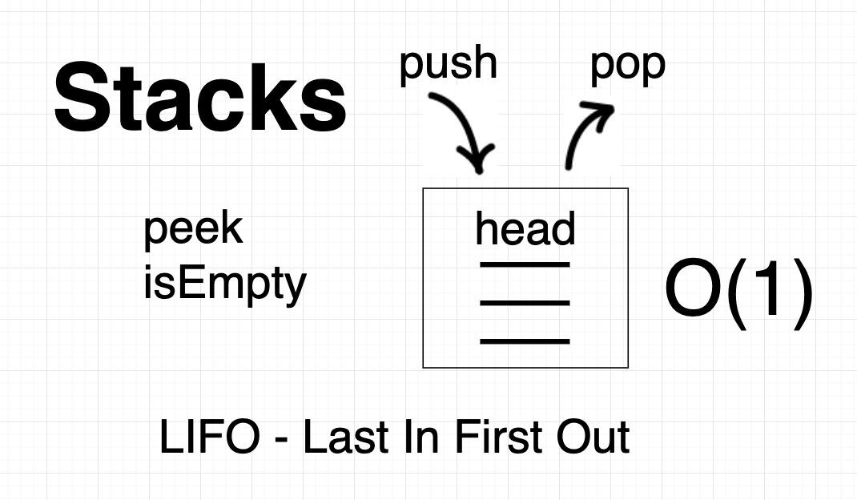
Stacks vs Queue

Slide 16
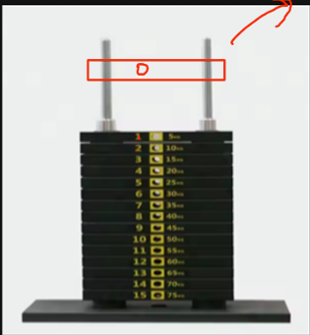
Stacks: LIFO/FILO
LIFO/FILO: Element which is put up last will be the first one out.

Slide 17
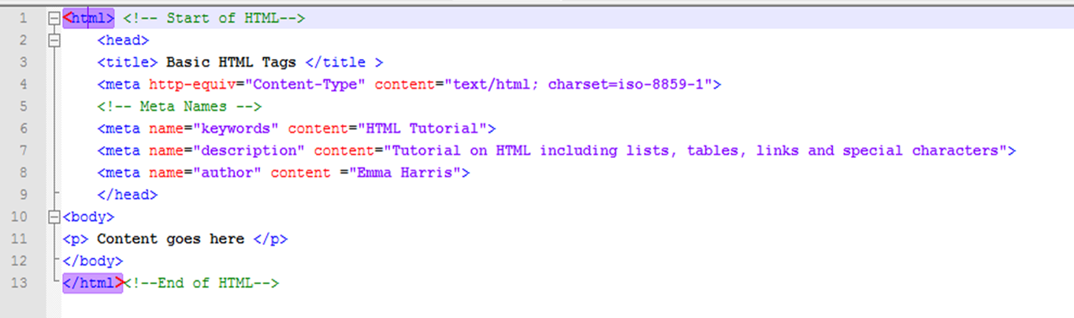
Industry example of Stack
Undo/redo operations
Call stack in programming
Matching HTML tags/branches
In back tracking algorithm
Decimal to Binary conversion
Reversing a string
Evaluating a Postfix Expression

Slide 18
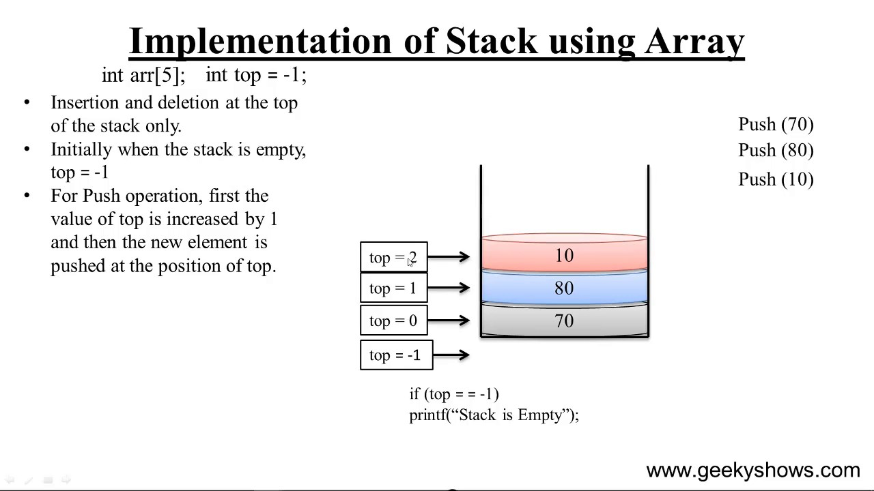
Stack Representation using array

Slide 19
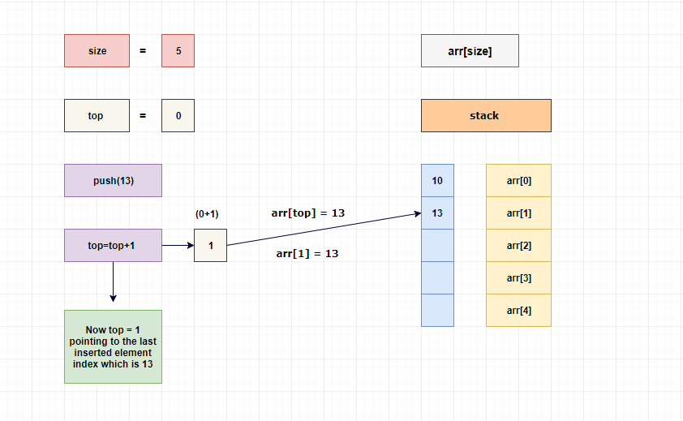
Stack Representation using array

Slide 20
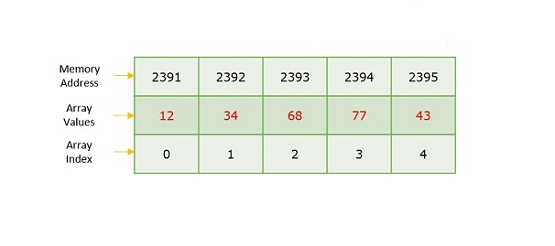
Stack Representation using array

Slide 21
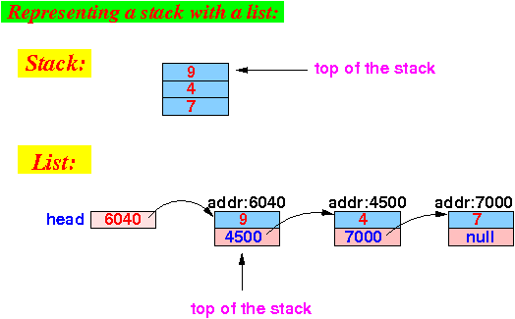
Stack Representation using Linked List

Slide 22
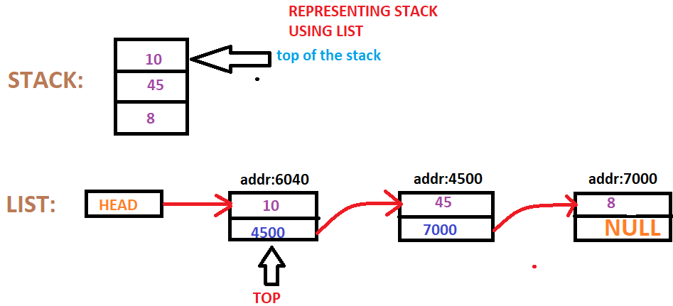
Stack Representation using Linked List

Slide 23
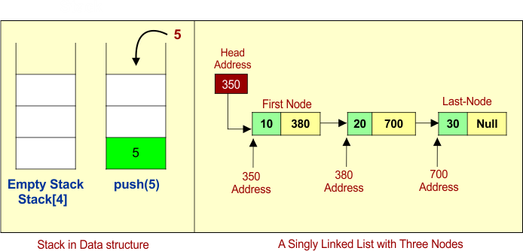
Stack Representation using Linked List

Slide 24
Visualization of stack
Array Stack Visualization: https://www.cs.usfca.edu/~galles/visualization/StackArray.html
2. Stack Visualizer: https://stack-visualizer-wheat.vercel.app/
3. Linked List (Single, Doubly), Stack, Queue, Deque – VisuAlgo: https://visualgo.net/en/list

Slide 25
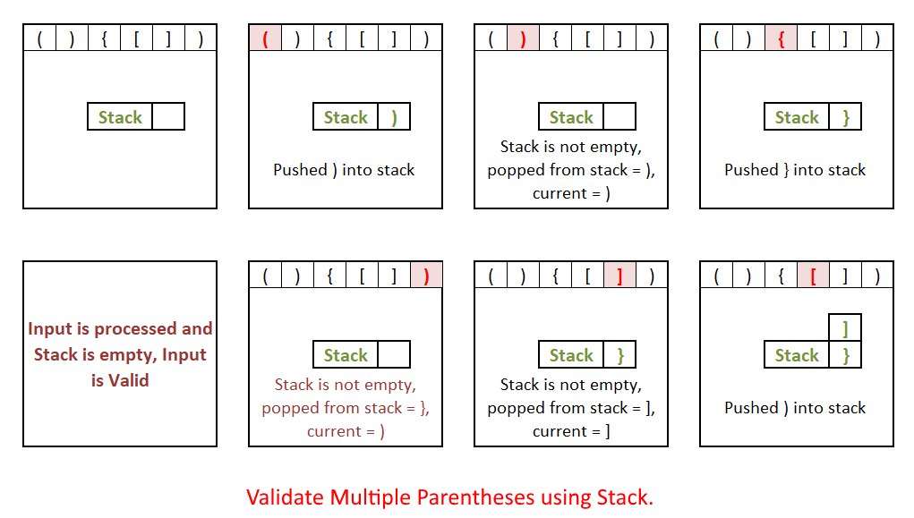
Stack Example:

Slide 26
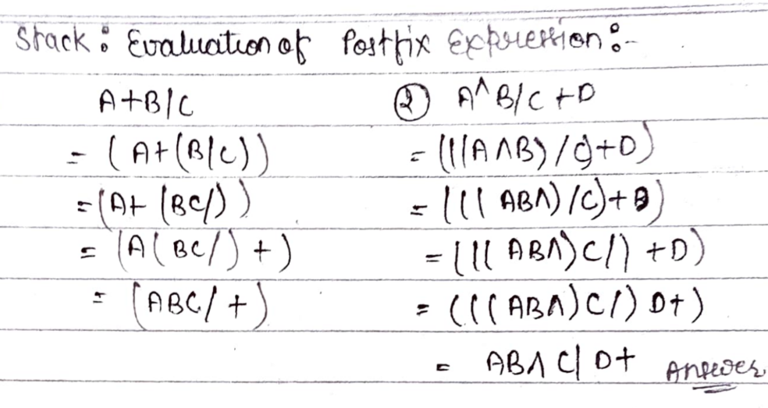
Evaluation of Postfix Expression

Slide 27
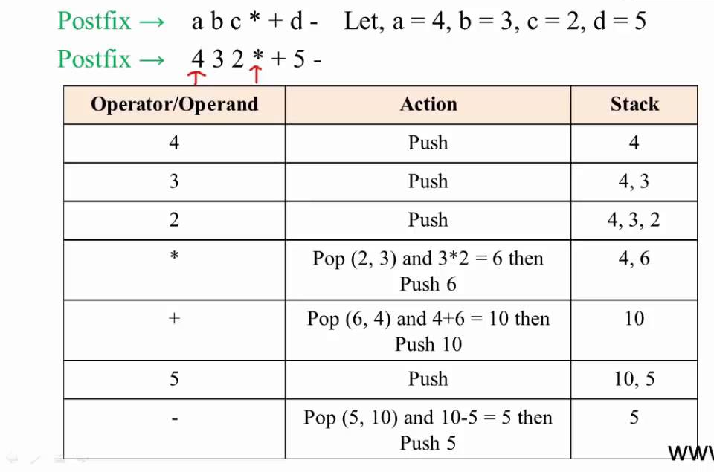
Evaluation of Postfix Expression

Slide 28
Thanking you !!!!
Any question !!!!!
Download PPT : https://github.com/sachin365123/Applies-Data-Structure-and-Application-GLA-Online-Sessions-Jan---Jun-2026

